Slide 1
Factors of Difficult Environmental Conditions
Alex Yeo
09Jan2024

Slide 2
Impacts of Difficult Environmental Conditions
Polluted environments with poor air quality has been cited to reduce a person’s lifespan by decades.
As a result of changing environmental conditions, we’ve seen more environmental disasters impact communities and it’s inhabitants.
What must we look out for as we focus on ideal living conditions that provide better long term potential for our health?

Slide 3
Research Objectives
Key Findings
Explore distributions of air quality around environmental factors.
Find environmental factors that show a relationship around both air quality and temperature.
Present existing solutions on how to remediate the critical environmental factors.
Higher temperature levels were correlated to higher levels of the following environmental factors:
Carbon monoxide levels
Relative humidity (%)
Nitrogen dioxide levels
Coarse particulate matter levels.
Fine particulate matter levels.
Population density
Sulfur Dioxide

Slide 4
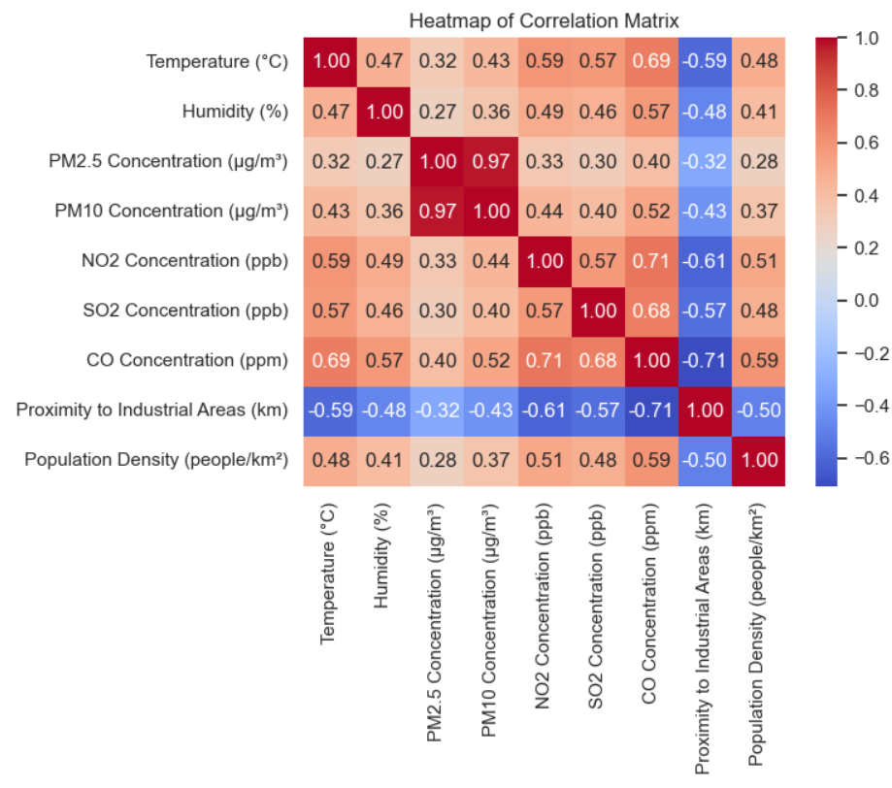
Data Exploration and Observations
Data around environmental factors that showed the highest correlation to temperature levels.
Nitrogen dioxide levels, Sulfur dioxide levels, Carbon monoxide levels, and proximity to industrial areas showed the highest correlation to temperature levels.

Slide 5
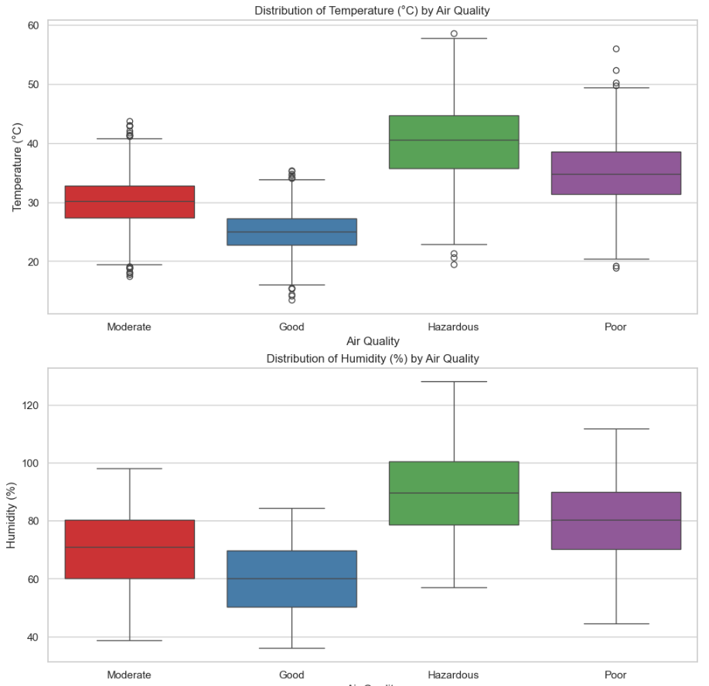
Data Exploration and Observations
On average, environments with hazardous and poor air quality had temperatures ranging from 35 degrees celsius to over 40 degrees celsius while showing 80-90% humidity.

Slide 6
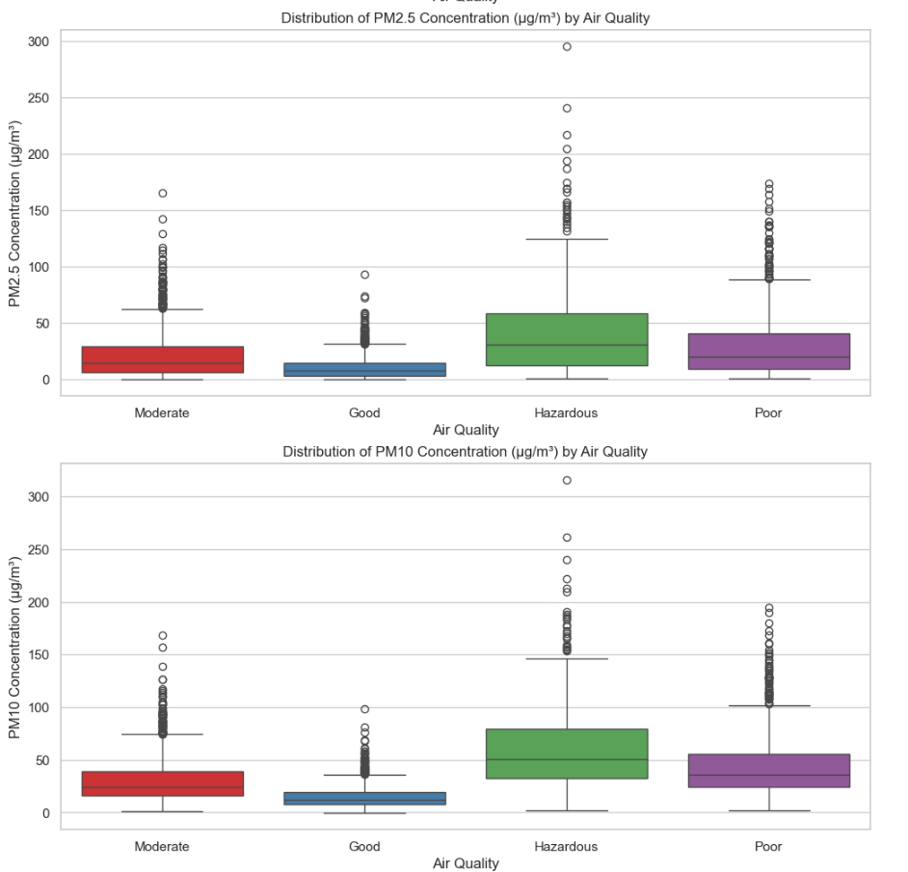
Data Exploration and Observations
On average, environments with hazardous and poor air quality had Fine particulate matter levels of 20 to 25 µg/m³, while having coarse particulate matter levels of 30 to 35 µg/m³.

Slide 7
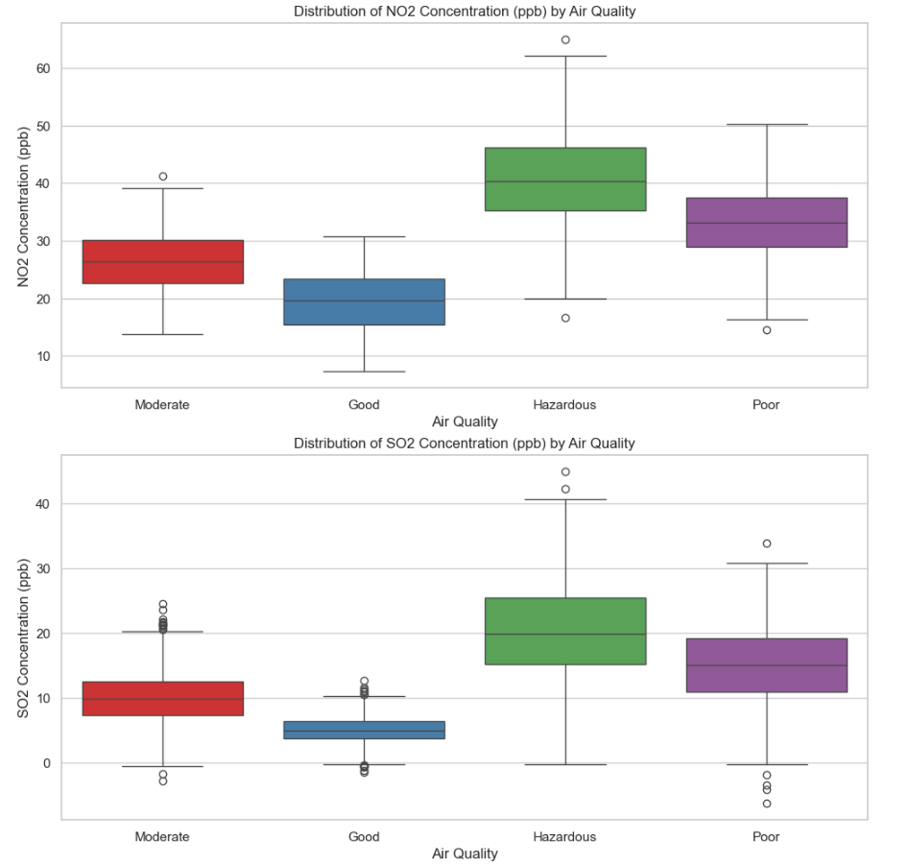
Data Exploration and Observations
On average, environments with hazardous and poor air air quality had nitrogen dioxide levels of 234 to 40 ppb, while having sulfur dioxide levels of 30 to 35 ppb.

Slide 8
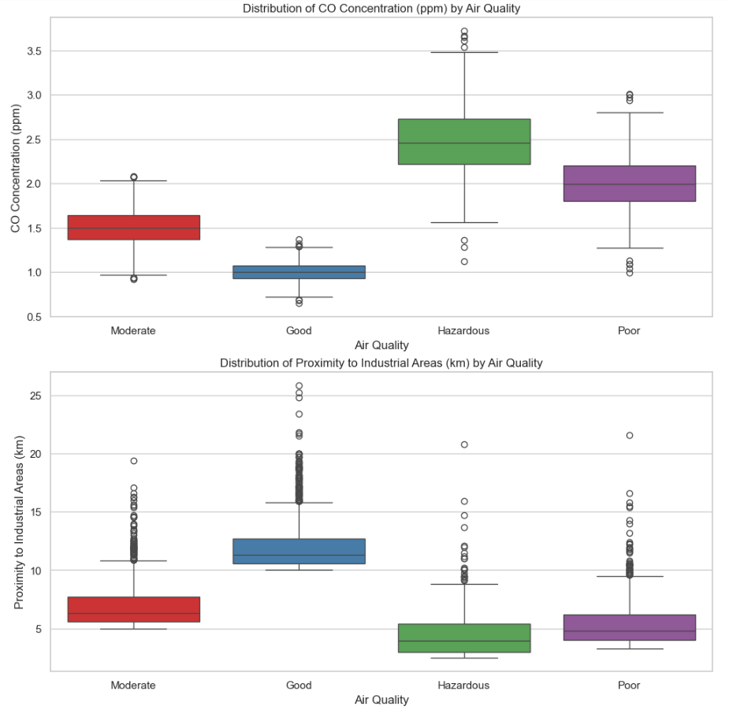
Data Exploration and Observations
On average, environments with hazardous and poor air quality had carbon monoxide levels of 1.98 to 2.48 ppm, while areas were 3.8k m to 4.9 km away from industrial areas.

Slide 9
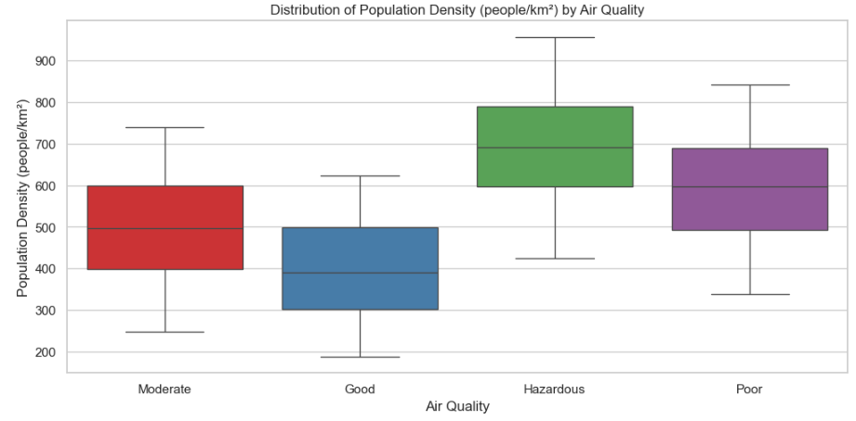
Data Exploration and Observations
On average, environments with hazardous and poor air quality had a population density of 600 to 698 people per square kilometer.

Slide 10
Reported sources of difficult environmental conditions:
Higher fine and coarse particulate matters:
Industrial emissions
Construction dust
Vehicle Exhaust
Industrial Processes
Nitrogen Dioxide, Sulfur Dioxide, Carbon Monoxide:
Combustion fossil fuels
Fuels containing sulfur (coal and oil)
Vehicle Exhaust and emissions

Slide 11
Actions
Stronger environmental and government policy regulations around industrial manufacturing and fuel regulations would alleviate significantly higher levels of environmental factors.
Explore and invest into alternate fuel sources and sustainable manufacturing initiatives that rely less on fossil fuels.
Enhance vehicle emission standards and implement improved traffic management such as carpool lanes.

